Slide 1
Creedmoor Powder Dispenser

Slide 2
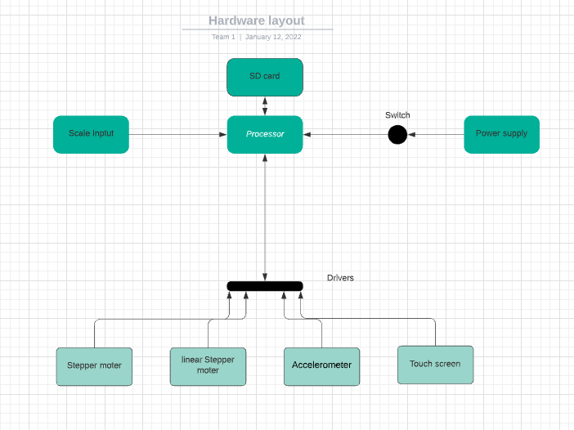
Weekly progress (Hardware)

Slide 3
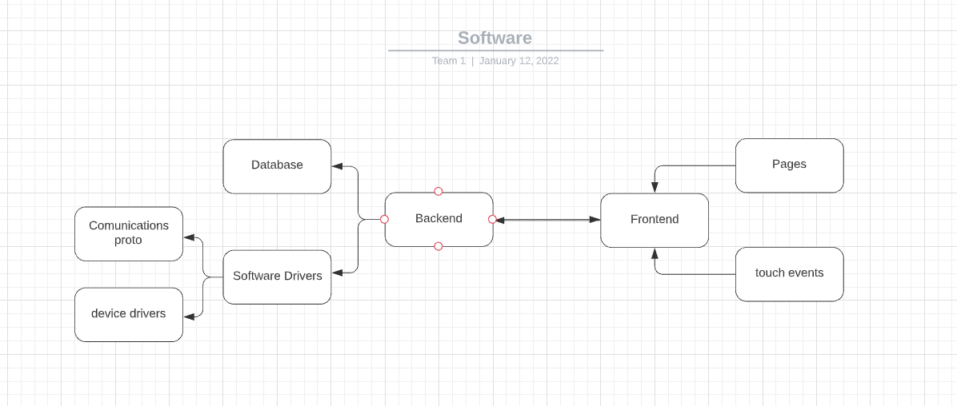
Weekly progress (software)

Slide 4
Week 1 (5-Jan to 11-Jan) Austin Stecklein
Goal/Task | % Done | Hours (Act.)
Everyone Complete Leadership Foundation: Clarify Purpose (p. 32-33), Team Purpose Statement (p. 34), Voice Finder (p. 64-67), Your Contribution Statement (p. 68), Win-Win Performance Agreement (p. 76) | 0 | 0
Team Complete: Project Objective / Mission Statement (clear and concise, <25 words, see example below) | 100 | .5
Team Complete: Project Task Template (A Gantt Chart) (Conditions or tasks that must be completed, work that needs to be done) | 0 | 0
Flow charts for hardware and software | 100 | 5.5
Example Project Objective / Mission Statements
Power Scale Dispenser:
Design, build, and test the electronics for the dispenser with a touch screen display and controlling two stepper motors by April 6, 2021 with a prototyping budget of $XXX USD and for less than 600 people-hours.
For ideas, also read Mission Questions in I-Learn | Content | Resources | Mission Questions
Hours on task during the week (On track ≥ 13 / wk) | 6
Total hours on task so far this semester (On track ≥ 13 hrs) | 13

Slide 5
Progress made during the week (Log) (What I did)
Created general software and hardware layout
Researched hardware parts

Slide 6
Difficulties encountered during the week (What I did not do and why)
Defining scope of project

Slide 7
Goals for this coming week (Ones that move the project forward the most)
Goal/Task | Stop Date (Est.) | Hours (Est.)
Selecting processor for project with rest of the group. | 1/14/21 | 1
Researching drivers for stepper motors | 1/16/21 | 2
developing backend framework with chosen programming language | 1/26/21 | 10
Estimated time needed to work on goals for this coming week (typ. 13 hrs) | 13

Slide 8
How can we help you achieve your goals?
Understanding more of the final product

Slide 9
Week 1 (5-Jan to 11-Jan) Jonathan Phillips
Goal/Task | % Done | Hours (Act.)
Everyone Complete Leadership Foundation: Clarify Purpose (p. 32-33), Team Purpose Statement (p. 34), Voice Finder (p. 64-67), Your Contribution Statement (p. 68), Win-Win Performance Agreement (p. 76)
Team Complete: Project Objective / Mission Statement (clear and concise, <25 words, see example below)
Team Complete: Project Task Template (A Gantt Chart) (Conditions or tasks that must be completed, work that needs to be done)
Power Scale Dispenser:
Design, build, and test the electronics for the dispenser with a touch screen display and controlling two stepper motors by April 6, 2021 with a prototyping budget of $XXX USD and for less than 600 people-hours.
Hours on task during the week (On track ≥ 13 / wk)
Total hours on task so far this semester (On track ≥ 13 hrs)

Slide 10
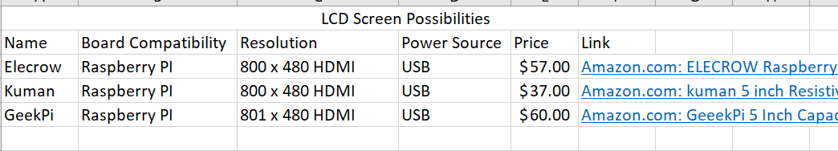
Progress made during the week (Log) (What I did)
Created a Gannt Chart for the layout for the hardware and software
Researched different LCDs that could be used for the touch screen display

Slide 11
Difficulties encountered during the week (What I did not do and why)
Did not order the LCD screen yet due to it needing to be approved first by the group

Slide 12
Goals for this coming week (Ones that move the project forward the most)
Goal/Task | Stop Date (Est.) | Hours (Est.)
Finalize parts for the project and order them | 1/13/22 | 1
Start Development on the Front End framework | 1/26/22 | 12
Estimated time needed to work on goals for this coming week (typ. 13 hrs) | 13

Slide 13
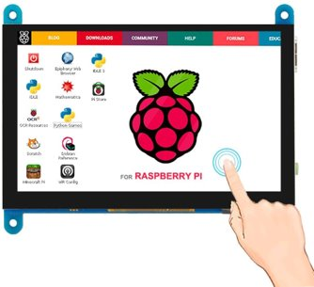
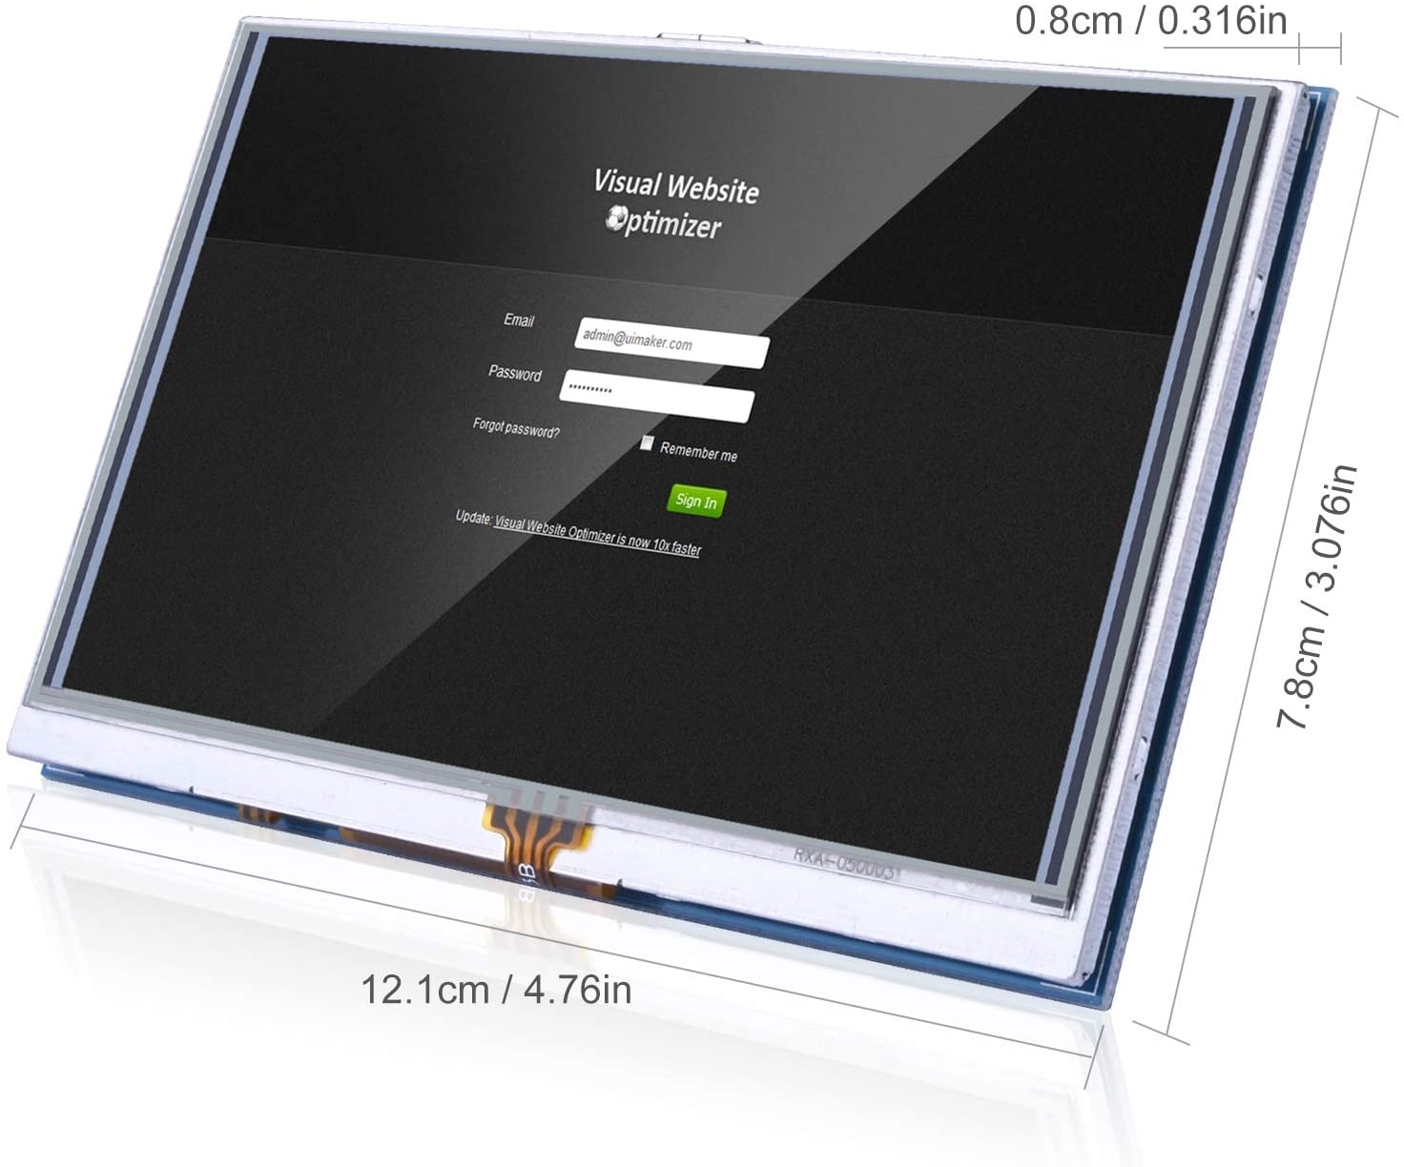
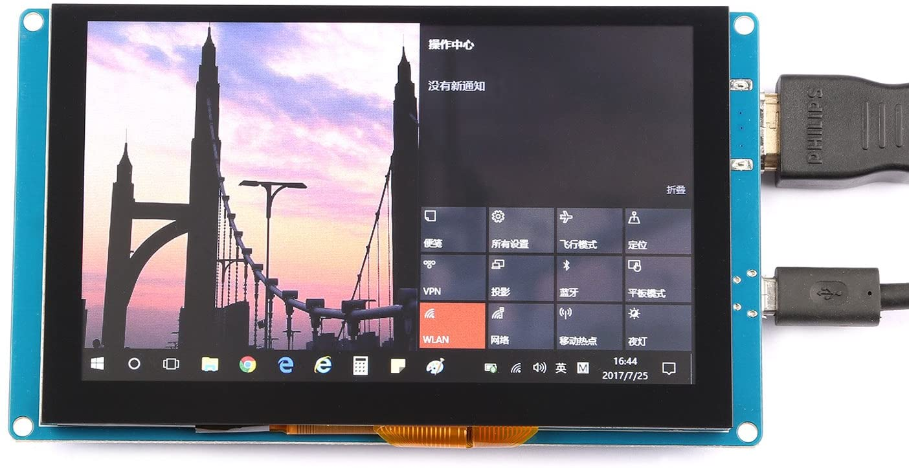
How can we help you achieve your goals?
Do you have a preference on what the screen will be?
Elecrow
Kuman
GeeekPi

Slide 14
Week 1 (5-Jan to 11-Jan) Dale Andreoli
Goal/Task | % Done | Hours (Act.)
Everyone Complete Leadership Foundation: Clarify Purpose (p. 32-33), Team Purpose Statement (p. 34), Voice Finder (p. 64-67), Your Contribution Statement (p. 68), Win-Win Performance Agreement (p. 76) | 0 | 0
Team Complete: Project Objective / Mission Statement (clear and concise, <25 words, see example below) | 100 | 1
Team Complete: Project Task Template (A Gantt Chart) (Conditions or tasks that must be completed, work that needs to be done) | 35 | 1
Example Project Objective / Mission Statements
Power Scale Dispenser:
Design, build, and test the electronics for the dispenser with a touch screen display and controlling two stepper motors by April 6, 2021 with a prototyping budget of $XXX USD and for less than 600 people-hours.
For ideas, also read Mission Questions in I-Learn | Content | Resources | Mission Questions
Hours on task during the week (On track ≥ 13 / wk) | 5
Total hours on task so far this semester (On track ≥ 13 hrs) | 5

Slide 15
Progress made during the week (Log) (What I did)
Researched potential processors

Slide 16
Difficulties encountered during the week (What I did not do and why)
Determining what we need to do and how to divide it

Slide 17
Goals for this coming week (Ones that move the project forward the most)
Goal/Task | Stop Date (Est.) | Hours (Est.)
Research potential processors | 1/14/21 | 2
Collaborate as a group to determine which processors would be best | 1/16/21 | 4
Research methods to implement necessary drivers | 1/26/21 | 6
Estimated time needed to work on goals for this coming week (typ. 13 hrs) | 12

Slide 18
How can we help you achieve your goals?
Clarify/Answer Questions

Slide 19
Week 1 (5-Jan to 11-Jan) Colby Hatton
Goal/Task | % Done | Hours (Act.)
Everyone Complete Leadership Foundation: Clarify Purpose (p. 32-33), Team Purpose Statement (p. 34), Voice Finder (p. 64-67), Your Contribution Statement (p. 68), Win-Win Performance Agreement (p. 76)
Team Complete: Project Objective / Mission Statement (clear and concise, <25 words, see example below)
Team Complete: Project Task Template (A Gantt Chart) (Conditions or tasks that must be completed, work that needs to be done)
Project Objective / Mission Statements
Power Scale Dispenser:
Design, build, and test the electronics for the dispenser with a touch screen display and controlling two stepper motors by April 6, 2021 with a prototyping budget of $XXX USD and for less than 600 people-hours.
For ideas, also read Mission Questions in I-Learn | Content | Resources | Mission Questions
Hours on task during the week (On track ≥ 13 / wk) | ~5
Total hours on task so far this semester (On track ≥ 13 hrs) | ~5

Slide 20
Progress made during the week (Log) (What I did)
Helped create general software and hardware layout
Purchased leadership book
Preliminary research

Slide 21
Difficulties encountered during the week (What I did not do and why)
No problems yet

Slide 22
Goals for this coming week (Ones that move the project forward the most)
Goal/Task | Stop Date (Est.) | Hours (Est.)
Find, compare, and form opinions on the correct processor for our project. | 1/14/22 | 4
Selecting processor for project with rest of the group. | 1/16/22 | 1
Obtain, test, and experiment with given hardware | 1/16/22 | 3
Class time, presentations, workbook, etc. | 1/16/22 | 4
Estimated time needed to work on goals for this coming week (typ. 13 hrs) | 13

Slide 23
How can we help you achieve your goals?
Communication - Ensure lines work and communication is clear.

Slide 24
Week 1 (5-Jan to 11-Jan) John Stinger
Goal/Task | % Done | Hours (Act.)
Everyone Complete Leadership Foundation: Clarify Purpose (p. 32-33), Team Purpose Statement (p. 34), Voice Finder (p. 64-67), Your Contribution Statement (p. 68), Win-Win Performance Agreement (p. 76)
Team Complete: Project Objective / Mission Statement (clear and concise, <25 words, see example below)
Team Complete: Project Task Template (A Gantt Chart) (Conditions or tasks that must be completed, work that needs to be done)
Power Scale Dispenser:
Design, build, and test the electronics for the dispenser with a touch screen display and controlling two stepper motors by April 6, 2021 with a prototyping budget of $XXX USD and for less than 600 people-hours.
Hours on task during the week (On track ≥ 13 / wk) | 12
Total hours on task so far this semester (On track ≥ 13 hrs) | 12

Slide 25
Progress made during the week (Log) (What I did)
Researched different processors and possible boards to use in the project.
Atmel ARM based microprocessor would be best.
Raspberry Pi Zero 2 would be effective and affordable, but generally unavailable.
Do we want a commercially available board?

Slide 26
Difficulties encountered during the week (What I did not do and why)
Select a specific processor. Needed to meet with the team to discuss options.

Slide 27
Goals for this coming week (Ones that move the project forward the most)
Goal/Task | Stop Date (Est.) | Hours (Est.)
Select a Processor |  | 1
Define the exact scope of the project |  | 2
Define individual roles |  | 1
Purchasing a Board |  | 2
Estimated time needed to work on goals for this coming week (typ. 13 hrs)

Slide 28
How can we help you achieve your goals?
More than one day to do research and meet with the team.

